Slide 1
Openstack Introduction
Zhang jiafang

Slide 2
Road map
Openstack basic concept
Openstack all in one setup and operate
Wind river Openstack environment

Slide 3
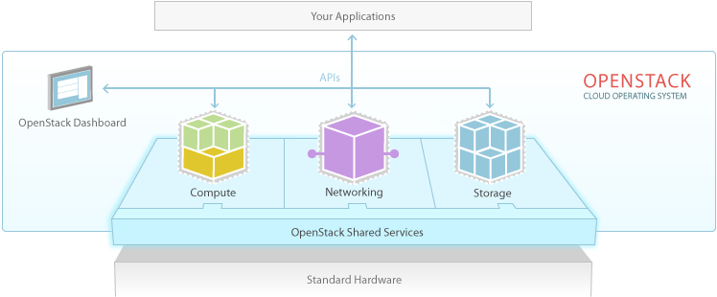
Compute: Xen QEMU KVM …
Networking: Open vSwitch
Storage: LVM

Slide 4
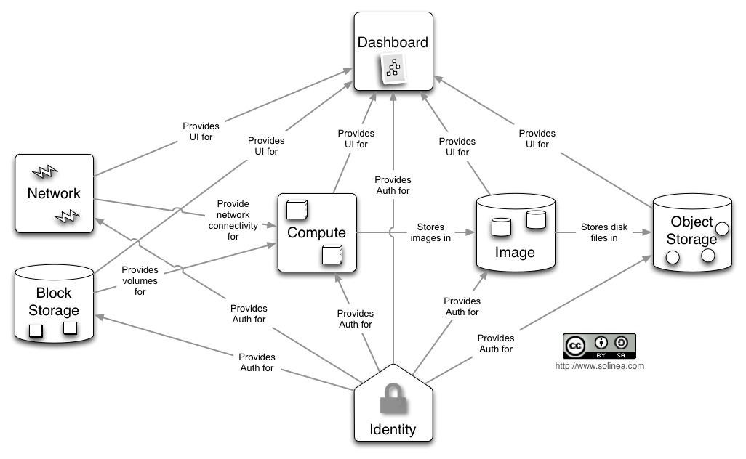
OpenStack Architecture - Conceptual Architecture

Slide 5
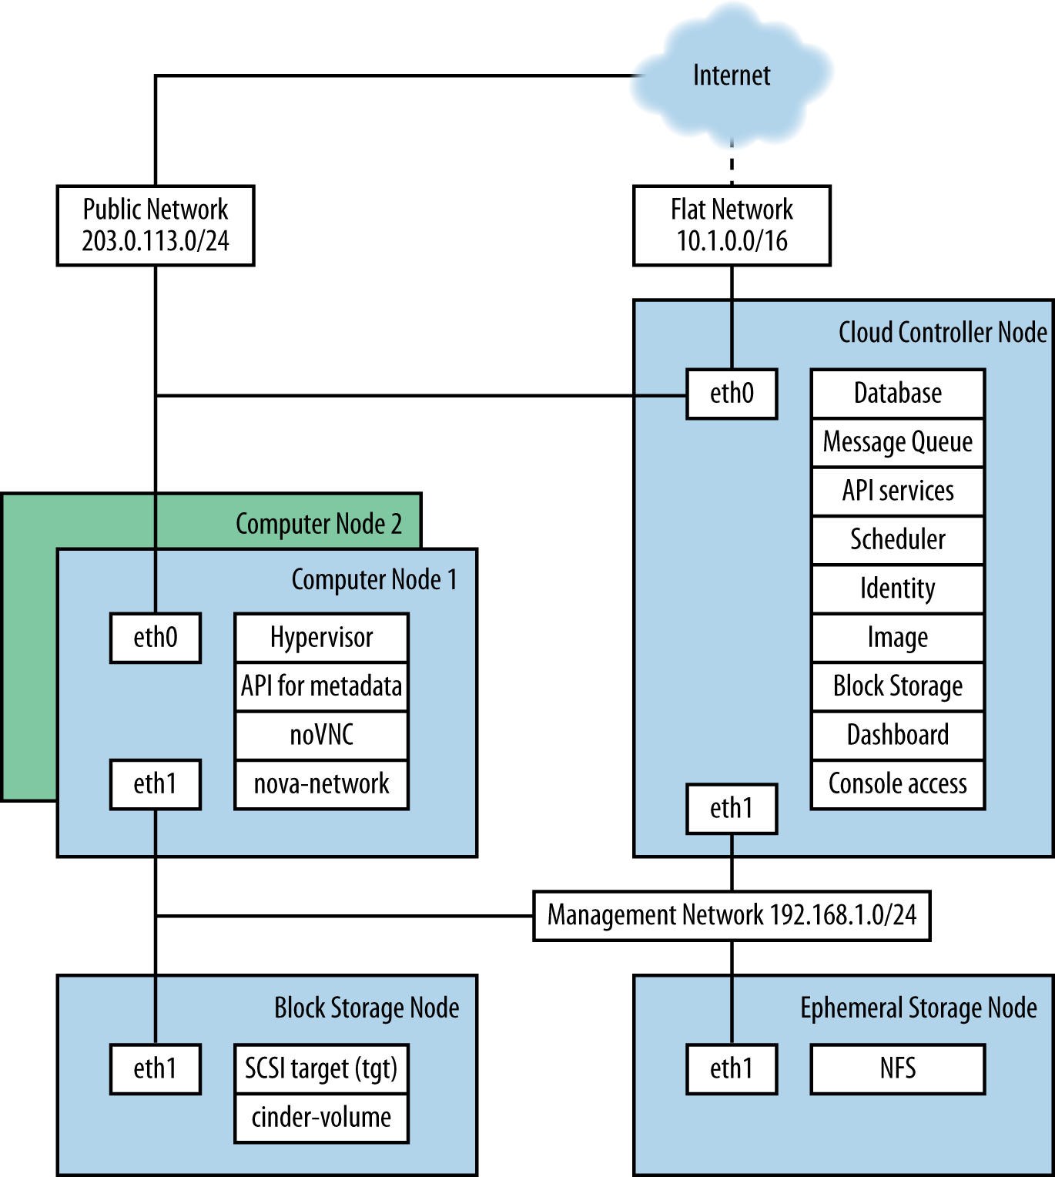

Slide 6
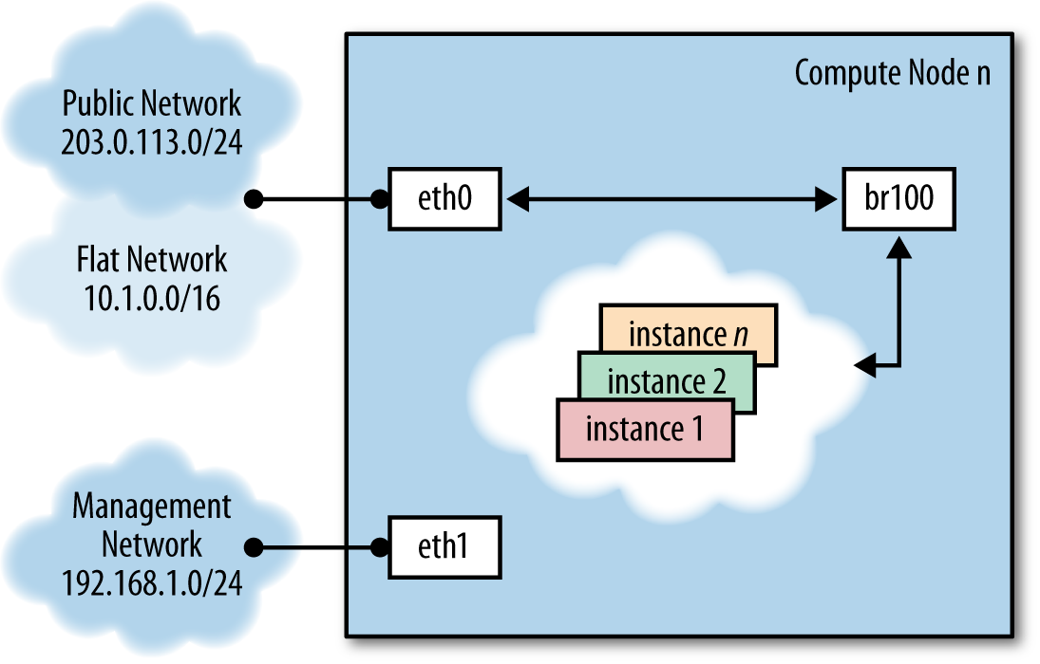

Slide 7
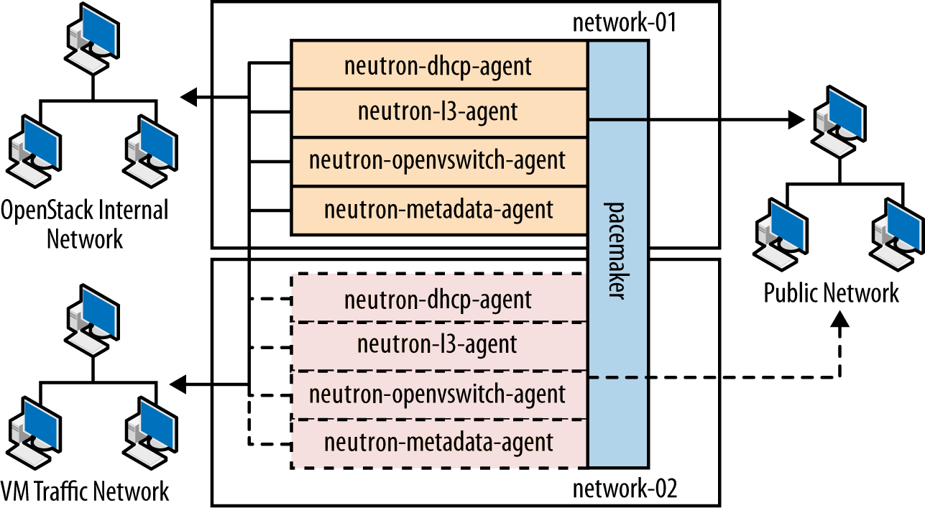

Slide 8
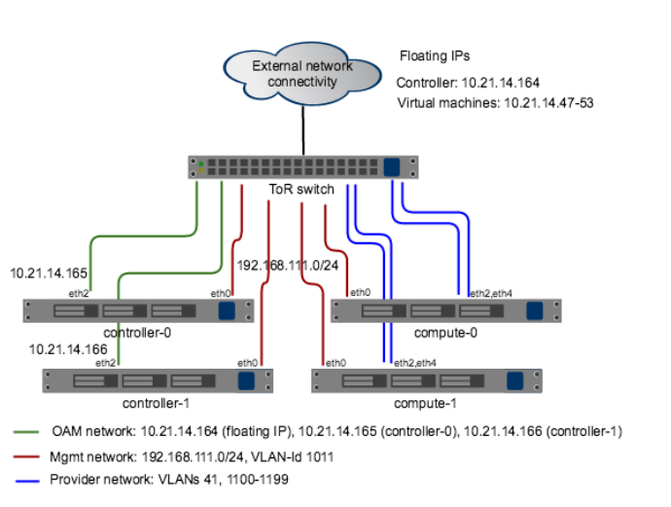

Slide 9

Wind River: non-redundant network connectivity with 1 / 1-5 configuration (eNB)
Based on Titanium 14.10
Public / OAM IP subnet
Controller node
Compute node 1 - 4
External Provider networks
SSH
OpenStack REST API’s
Horizon UI
Virtual machine
Virtual machine
Rabbit MQ
Virtual machine
SQL DB
Cinder LVM iSCSI
SSH
PXE/DHCP/TFTP
SSH
Nova compute
OVS ML2 agebt
L3 Agent
DHCP agent
External traffic ports pass only Provider bridge VLAN range, e.g. 100…199
Mgmt IP
OAM
Mgmt IP
AVS
ILO
BIOS PXE
ILO
BIOS PXE
LAG Bond (XOR)
10 GE switch
SFP+
SFP+
SFP+
VLAN30
VLAN40
VLAN40
RJ45
SFP+
RJ45
RJ45
SFP+
RJ45
RJ45
SFP+
SFP+
VLAN10
SFP+
VLAN20
SFP+
SFP+
VLAN30
SFP+
VLAN20
SFP+
VLAN40
LAG
SFP+
SFP+
VLAN10
SFP+
Internal VLAN’s, not visible to host computers

Slide 10
Openstack environment setup
sudo apt-get install git
sudo apt-get install pip
export https_proxy="https://10.144.1.10:8080/"
export http_proxy="http://10.144.1.10:8080/"
export no_proxy="local,localhost,127.0.0.1,10.0.2.15"
export | grep http
git clone –b stable/liberty https://git.openstack.org/openstack-dev/devstack
cd devstack
vi stackrc
GIT_BASE=${GIT_BASE:-https://git.openstack.org}
./stack.sh

Slide 11
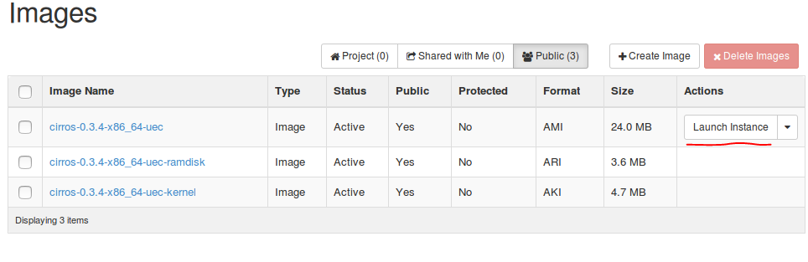
Create VMS
Sudo virsh list –all
Sudo apt-get install vncviewer
Virsh vncdispaly xxx_name

Slide 12
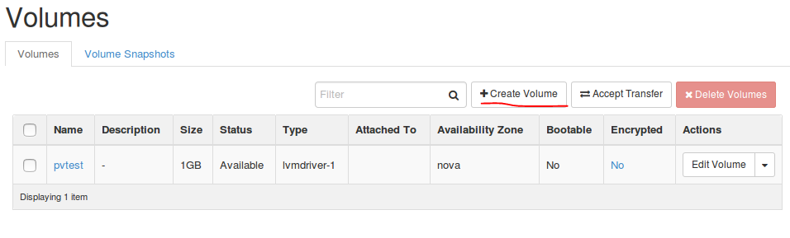
Create volumes

Slide 13
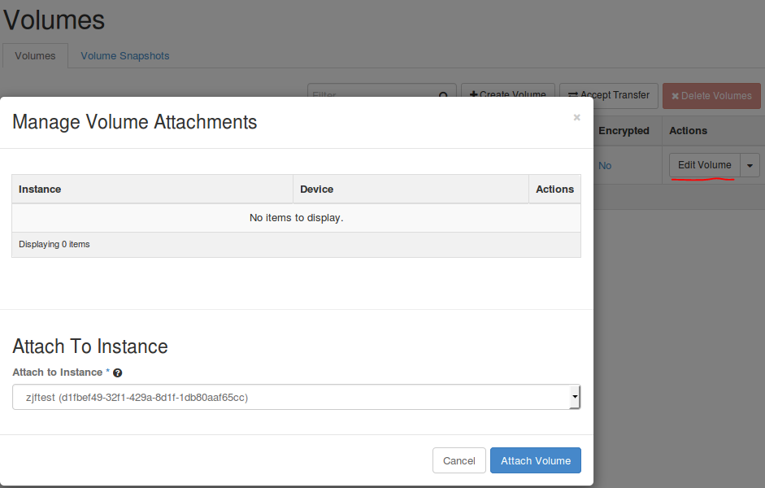
Attaching the block storage to an instance

Slide 14
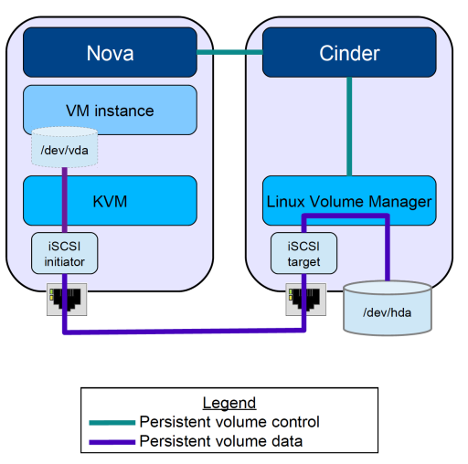

Slide 15
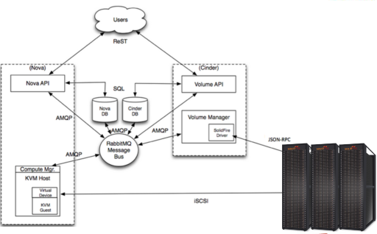

Slide 16
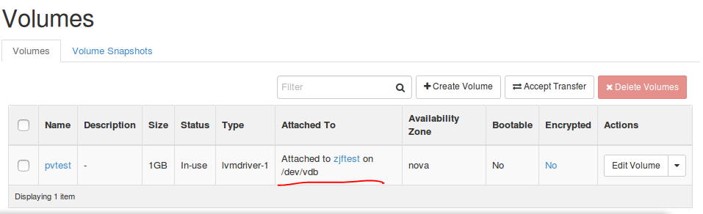
Ls /dev/vd*
/dev/vdb

Slide 17
Format device
instance# fdisk /dev/vdb
Command (m for help): n
Partition type:
p primary (0 primary, 0 extended, 4 free)
e extended
Select (default p): p
Partition number (1-4, default 1): 1
First sector (2048-2097151, default 2048):
Last sector, +sectors or +size{K,M,G,T,P} (2048-2097151,
default 2097151):
Created a new partition 1 of type 'Linux' and of size 1023
MiB.
Command (m for help): w
The partition table has been altered.
instance# mkfs -t ext4 /dev/vdb1
Writing superblocks and filesystem accounting information:
done
control# mount /dev/vdb1 /mnt
control# echo "test" > /mnt/test
control# cat /mnt/test
test

